Slide 1
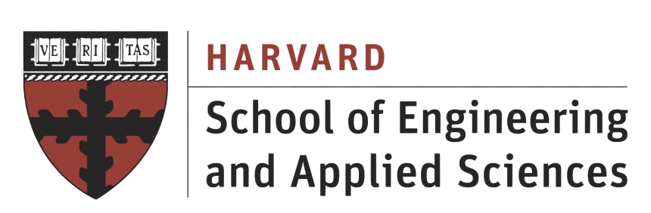
AI-Guided Discovery of Combustion-Stability Windows
Can adaptive exploration find rare unstable regimes with fewer expensive CFD evaluations?
James Lu - Harvard University
Open Exploration Problems
GOAI Seminalist Defense
Notes:
My project asks a simple question: when CFD evaluations are expensive, can adaptive AI exploration find scientifically important rare regimes more efficiently than conventional space-filling sampling?
I study this using combustion-stability-window exploration. The goal is to build a controlled, inspectable environment where OpenFOAM provides mixing physics, and an AI agent decides which simulations to run next.

Slide 2
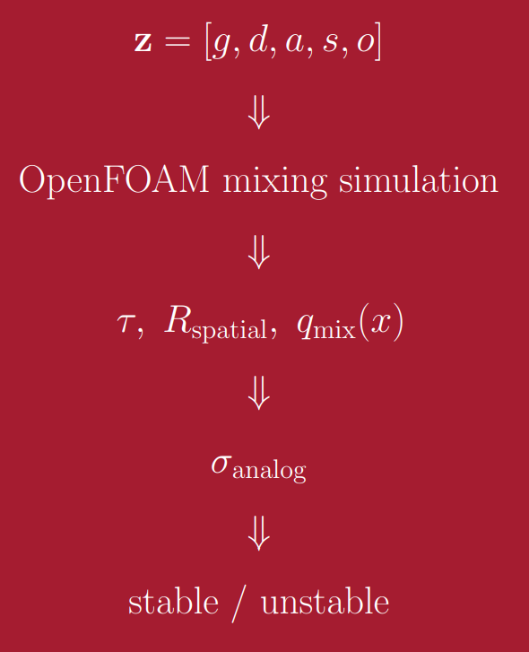
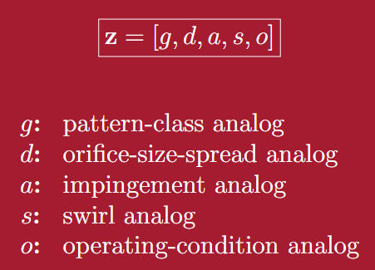
WORKFLOW
Notes:
The workflow is: choose a five-dimensional design vector, run an OpenFOAM mixing simulation, extract mixing quantities, convert them into a Rayleigh-inspired stability indicator, and classify the point as stable or unstable.
The five explored variables are pattern class, orifice-size spread, impingement, swirl analog, and operating-condition analog. The AI does not see the full surface. It only receives one result at a time.

Slide 3
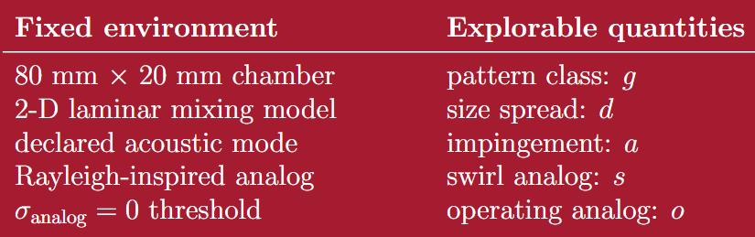
EXPLORATION ENVIRONMENT
Notes:
The environment is fixed: same chamber, same CFD model, same acoustic analog, and the same σanalog=0\sigma_{\text{analog}}=0 threshold.

Slide 4
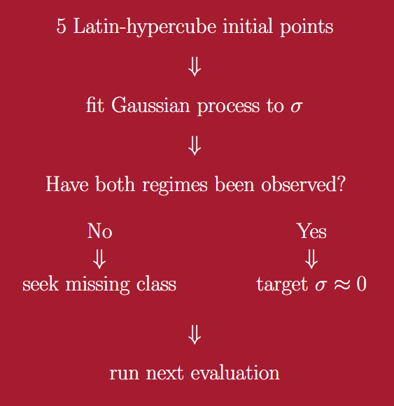
AI LOGIC: HOW DOES AI CHOOSE?
Notes:
The AI begins with Latin-hypercube initial samples, so it does not get an unfair starting advantage. After that, it fits a Gaussian-process model to σ\sigma. If it has only seen one regime, it searches for the missing regime. Once it has seen both stable and unstable cases, it targets the boundary near σ=0\sigma=0.

Slide 5
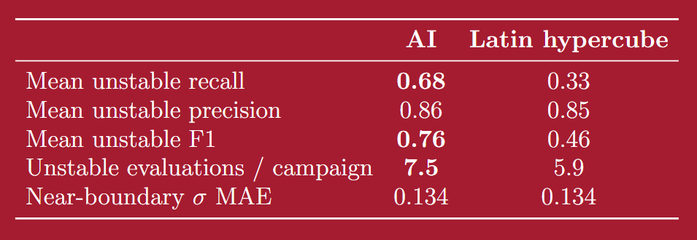
PRIMARY LIVE-CFD RESULT
Adaptive exploration recovered the rare unstable
regime more effectively.
AI had higher unstable recall, sampled more unstable conditions
in 7 of 8 live OpenFOAM campaigns.
Notes:
The main result is rare-regime recovery.
Across eight matched live OpenFOAM campaigns, adaptive exploration achieved mean unstable recall of 0.68, compared with 0.33 for Latin hypercube. It found more unstable cases in seven of eight seeds.
This is not a claim that AI wins every metric. Precision is essentially tied, near-boundary error is tied, and I kept the reversal seed where Latin hypercube does better.

Slide 6
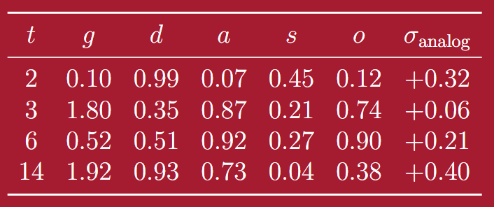
SCIENTIFIC DISCOVERY
In live seed 14, the adaptive campaign independently encountered unstable five-dimensional designs at both low and high values of the pattern-class variable g.
Because the other coordinates also differed, those observations did not prove that
g itself caused the behavior. Instead, they suggested a testable hypothesis: is
the response nonmonotonic in g?
A controlled follow-up sweep then varied g while holding d, a, s, and o fixed
Notes:
A scientific story that arose from this is seed 14.
In that campaign, the AI independently found unstable designs at both low and high values of the pattern-class variable gg. Because other coordinates changed too, this did not prove causality. Instead, it suggested a follow-up question: is the response nonmonotonic in g?

Slide 7
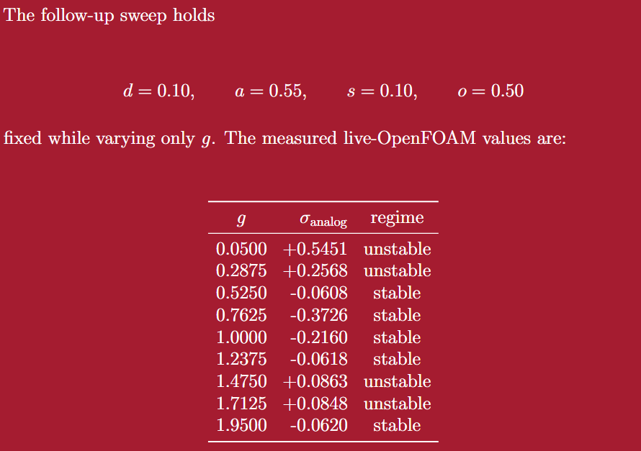
SCIENTIFIC DISCOVERY

Slide 8
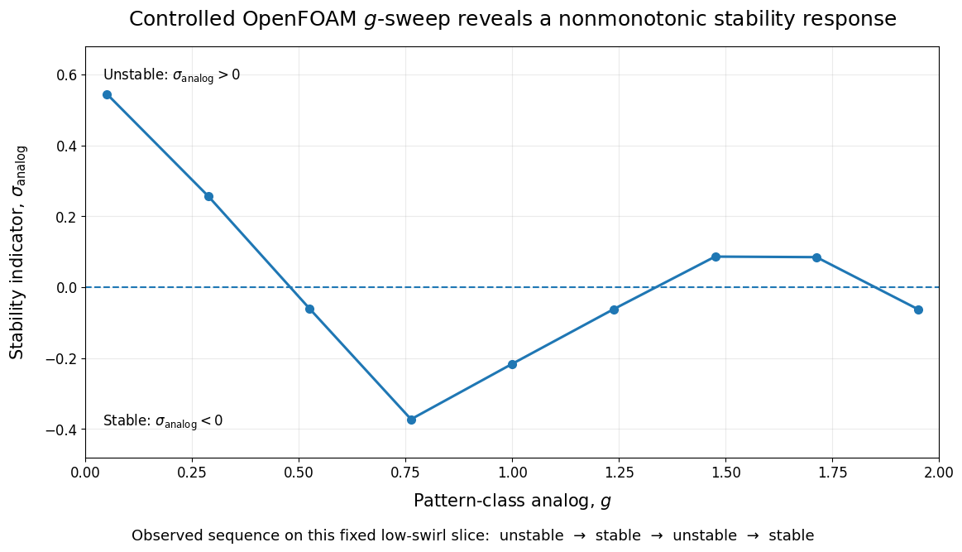
SCIENTIFIC DISCOVERY
AI did more than identify unstable regimes: it helped reveal a follow-up question to be solved
Notes:
I then ran a controlled sweep where g changed while the other variables were fixed. That sweep showed an unstable low-gg region, a stable middle region, and another unstable interval at higher g.

Slide 9
CONCLUSION
Within the declared CFD-informed stability analog, adaptive exploration finds the scientifically important unstable class more efficiently than equal-budget space-filling sampling.
The value of the AI is not only improved rare-regime recovery: unexpected samples can also be converted into targeted scientific follow-up experiments.
The strongest result is a combination of method and science: AI preferentially recovers rare instability and identifies observations that motivate controlled tests of nonmonotonic structure
Notes:
So the conclusion is two-part.
Methodologically, adaptive exploration uses the same small CFD budget more effectively to recover the rare unstable regime.
Scientifically, it turns unexpected observations into targeted follow-up experiments. In this case, that follow-up revealed nonmonotonic structure in the declared stability analog.
Again, the claim is bounded: this is a CFD-informed Rayleigh analog, not a flight-engine stability prediction.

Slide 10
THANK YOU
I will now move on to the live demonstration.

